Slide 1
Data Preprocessing ——Descriptive Data Summarization——
徐华
清华大学 计算机系 智能技术与系统国家重点实验室
xuhua@tsinghua.edu.cn

Slide 2
Data Preprocessing
About data
Why preprocess the data?
Descriptive data summarization
Data cleaning
Data integration and transformation
Data reduction
Discretization and concept hierarchy generation
Summary

Slide 3
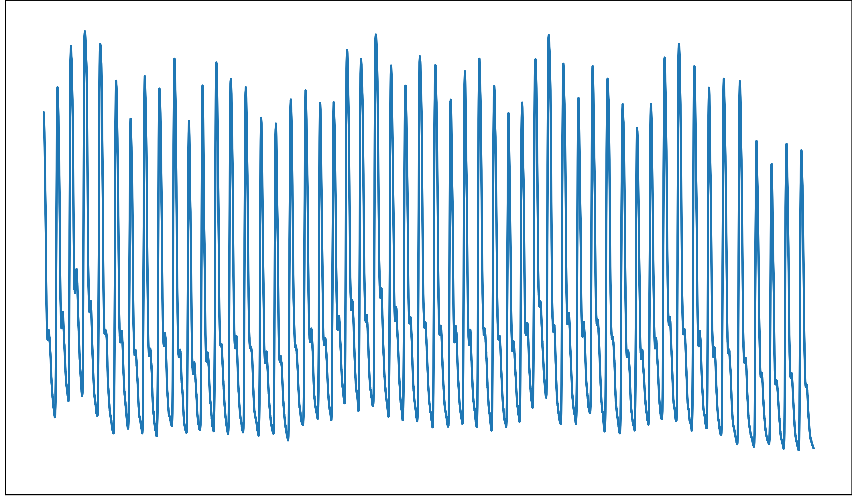
Motivation
Motivation
To better understand the data
To get overall picture of data
Descriptive data summarization
Central tendency (集中趋势)
Dispersion (散布性)
Wrist Pulse Signal

Slide 4
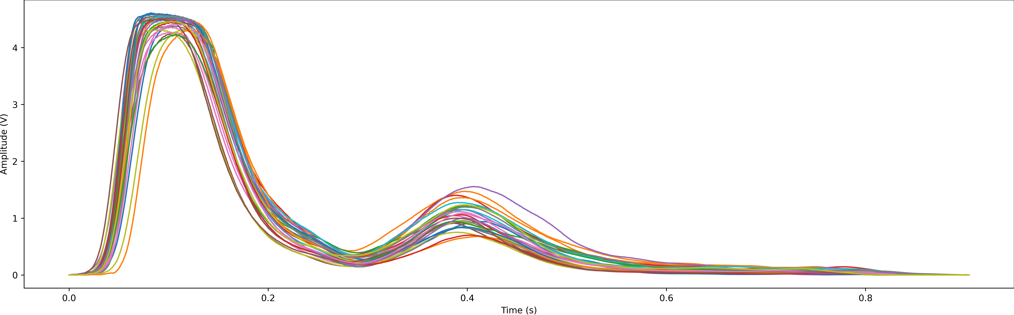
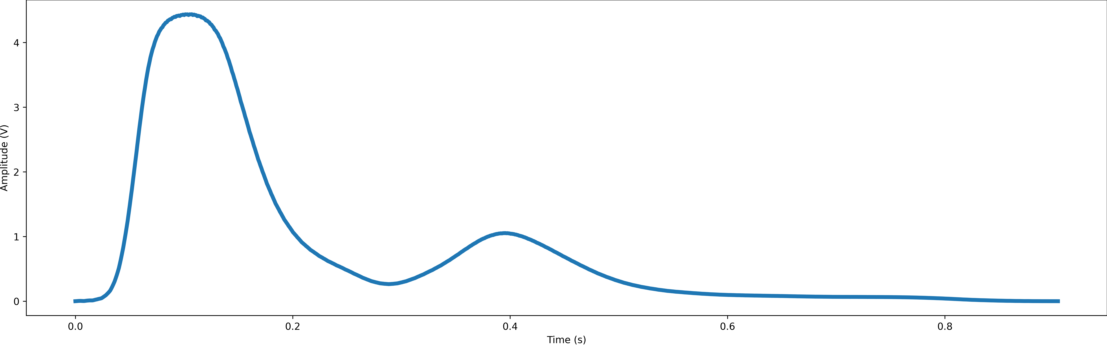
Motivation

Slide 5
Three Categories of Measurement
Distributive（分布的）: if the result derived by applying the function to n aggregate values is the same as that derived by applying the function on all the data without partitioning.
count(), sum(), min(), max()
Algebraic（代数的）: if it can be computed by an algebraic function with M arguments (where M is a bounded integer), each of which is obtained by applying a distributive aggregate function.
avg() 均值——聚集函数, min_N(), standard_deviation()——标准偏差
Holistic（整体的）: if there is no constant bound on the storage size needed to describe a subaggregate.
median()——中位数, mode()——众数, rank()

Slide 6
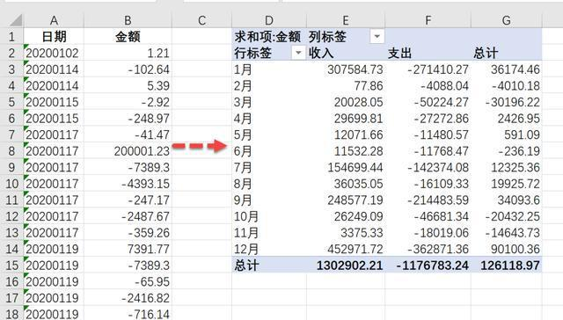
Three Categories of Measurement
Value Aggregation v.s. Data Granularity
Coarse-Grained Data (粗粒度)
Fine-Grained Data (细粒度)

Slide 7
Measuring the Central Tendency(1)
Mean (均值，Algebraic Measure)
Arithmetic mean:
Weighted arithmetic mean:
Trimmed mean(截断均值): chopping extreme values
e.g. Salary and grade

Slide 8
Measuring the Central Tendency(2)
Median (中位数, holistic measure)
Middle value if odd number of values, or average of the middle two values otherwise
Data 57 55 85 24 33 49 94 2 8 51 71 30 91 6 47 50 65 43 41 7
Ordered Data
2 6 7 8 24 30 33 41 43 47 49 50 51 55 57 65 71 85 91 94
Median 48

Slide 9
Measuring the Central Tendency(4)
Mode
Value that occurs most frequently in the data
Unimodal（单峰）, bimodal（双峰）, trimodal（三峰）
Empirical formula:
For unimodal（单峰） frequency:

Slide 10
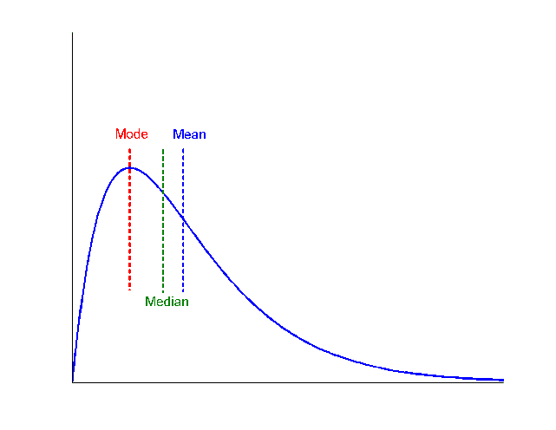
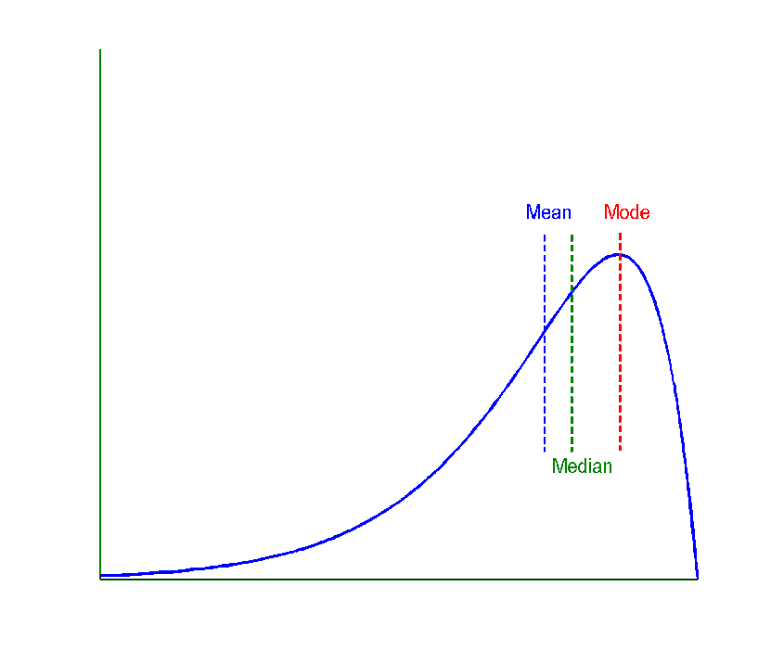
Symmetric v.s. Skewed Data
Median, mean and mode of symmetric, positively and negatively skewed data

Slide 11
Measuring the Dispersion of Data(1)
Quartiles, outliers and boxplots
Quartiles(4分位数): Q1 (25th percentile), Q3 (75th percentile)
Inter-quartile range（中间四分位数极差）: IQR = Q3 – Q1
Five number summary（五数概括）: min, Q1, M, Q3, max
Boxplot（盒图）: ends of the box are the quartiles, median is marked, whiskers(外边界), and plot outlier individually
Outlier: usually, a value higher/lower than 1.5 x IQR

Slide 12
Measuring the Dispersion of Data(2)
Variance（方差） and standard deviation（标准差）
Variance s²: (algebraic, scalable computation)
Standard deviation s is the square root of variance s²

Slide 13
Properties of Normal Distribution Curve
The normal (distribution) curve
From μ–σ to μ+σ: contains about 68% of the measurements
(μ: mean, σ: standard deviation)
From μ–2σ to μ+2σ: contains about 95% of it
From μ–3σ to μ+3σ: contains about 99.7% of it

Slide 14
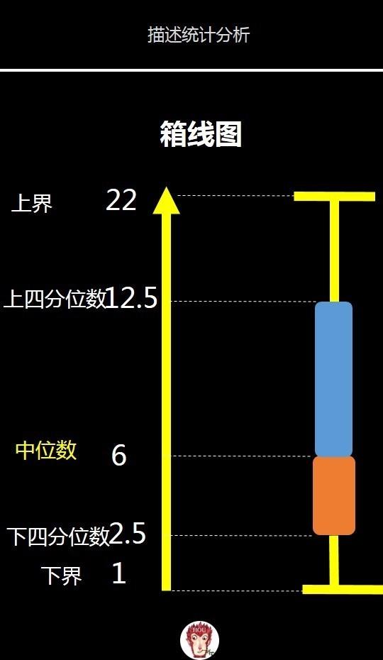
Boxplot Analysis
Five-number summary of a distribution:
Minimum, Q1, M, Q3, Maximum
Boxplot
Data is represented with a box
The ends of the box are at the first and third quartiles, i.e., the height of the box is IRQ
The median is marked by a line within the box
Whiskers: two lines outside the box extend to Minimum and Maximum

Slide 15
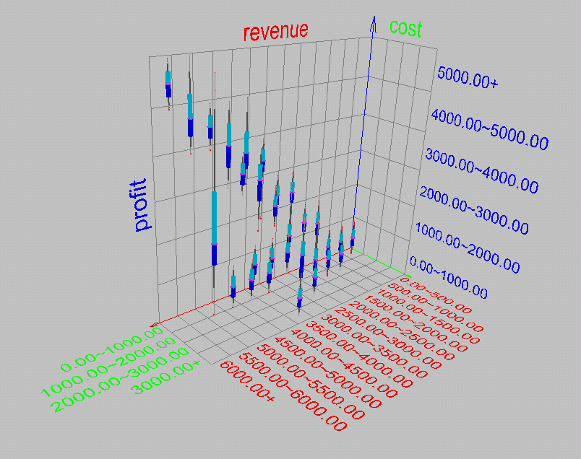
Visualization of Data Dispersion: Boxplot Analysis

Slide 16
Histogram Analysis
Graph displays the basic statistical class descriptions
Frequency histograms（频率直方图）
A univariate graphical method
Consists of a set of rectangles that reflect the counts or frequencies of the classes present in the given data

Slide 17
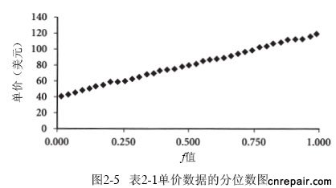
Quantile Plot（分位数图）
Displays all of the data (allowing the user to assess both the overall behavior and unusual occurrences)
Plots quantile information
For a data x_{i} data sorted in increasing order, f_{i} indicates that approximately 100 f_{i}% of the data are below or equal to the value x_{i}

Slide 18
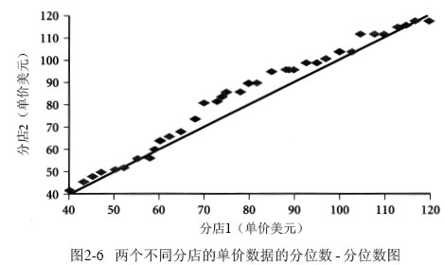
Quantile-Quantile (Q-Q) Plot
Graphs the quantiles（分位数） of one univariate distribution against the corresponding quantiles of another
Allows the user to view whether there is a shift in going from one distribution to another

Slide 19
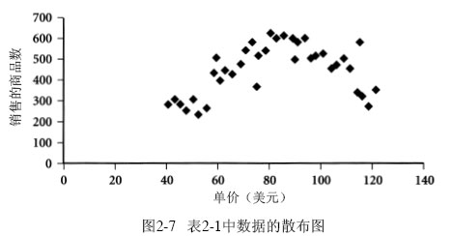
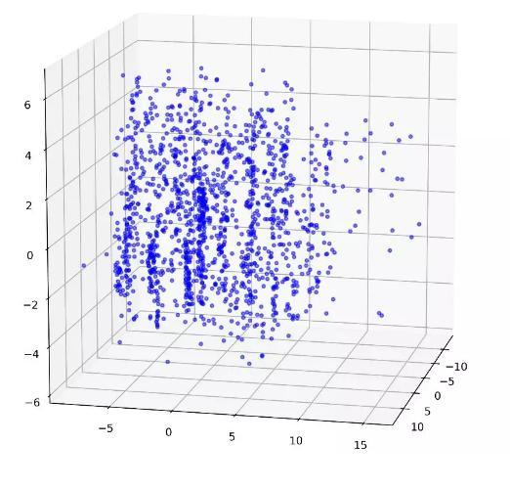
Scatter plot(散布图)
Provides a first look at bivariate data to see clusters of points, outliers, etc
Each pair of values is treated as a pair of coordinates and plotted as points in the plane

Slide 20
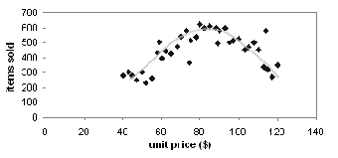
Loess Curve（局部回归曲线）
Adds a smooth curve to a scatter plot in order to provide better perception of the pattern of dependence
Loess curve is fitted by setting two parameters: a smoothing parameter, and the degree of the polynomials that are fitted by the regression

Slide 21
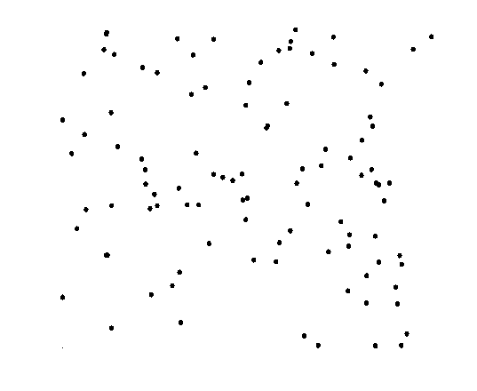
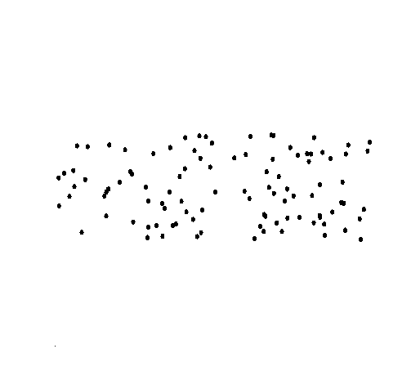
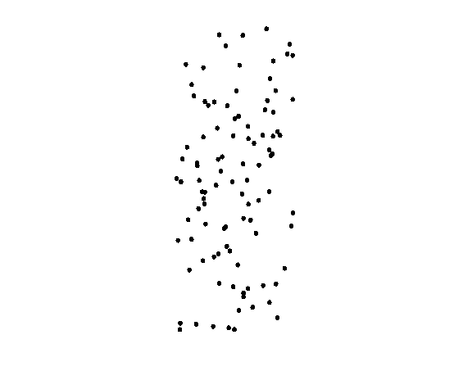
Correlated Data
Positively and Negatively Correlated Data
Not Correlated Data

Slide 22
Graphic Displays of Basic Statistical Descriptions
Histogram: (shown before)
Boxplot: (covered before)
Quantile plot: each value x_{i} is paired with f_{i} indicating that approximately 100 f_{i} % of data are ≤ x_{i}
Quantile-quantile (q-q) plot: graphs the quantiles of one univariant distribution against the corresponding quantiles of another
Scatter plot: each pair of values is a pair of coordinates and plotted as points in the plane
Loess (local regression) curve: add a smooth curve to a scatter plot to provide better perception of the pattern of dependence.

Slide 23
Thanks！
Notes:
工作新意图发现

